Slide 1

Talking Transportation Technology (T3) Webinars
Data Sources and Management Part 2 of 5 in the Crowdsourcing for Operations Course via Webinar
Course developed by the Federal Highway Administration (FHWA) Every Day Counts (EDC)
Crowdsourcing for Operations
Tuesday, June 20, 2023 – 1:00PM ET

Slide 2


Talking Transportation Technology (T3) Webinars are brought to you by the Intelligent Transportation Systems (ITS) Professional Capacity Building (PCB) Program of the U.S. Department of Transportation’s (USDOT) ITS Joint Program Office (JPO)
For more information, visit: www.pcb.its.dot.gov

Slide 3
PDH Policy
The T3 Webinar Program does not officially offer Professional Development Hours (PDHs); however, your participation in a T3 Webinar may qualify as PDH-eligible activity with your licensing agency.
Upon request, the T3 Webinar Program can provide a letter verifying your attendance. Please contact T3@dot.gov to make a request.
For more information, please visit: https://www.pcb.its.dot.gov/t3_pdh_policy.aspx

Slide 4

Ask a Question / Make a Comment
Use the Chat Pod
Click on Chat icon on your screen
Submit your question or comments in the Chat window
Questions/comments will be addressed after the last presentation, as time permits

Slide 5
Data Sources and Management Part 2 of 5 in the Crowdsourcing for Operations Course via Webinar
Intelligent Transportation Systems Joint Program Office (ITS JPO) Professional Capacity Building (PCB) Program Presents
June 20, 2023
Course developed by the Federal Highway Administration (FHWA) Every Day Counts (EDC) Crowdsourcing for Operations Innovation, and delivered by the FHWA Office of Operations

Slide 6
DISCLAIMER
The U.S. Government does not endorse products or manufacturers. Trademarks or manufacturers’ names appear in this presentation only because they are considered essential to the objective of the presentation. They are included for informational purposes only and are not intended to reflect a preference, approval, or endorsement of any one product or entity.
This presentation was created and is being co-presented by both FHWA and outside parties. The views and opinions expressed during this presentation are the presenters' and do not necessarily reflect those of FHWA or the U.S. Department of Transportation (USDOT)

Slide 7



Today’s Host and Presenters
Ralph Volpe, Host
EDC-6 Crowdsourcing Colead
FHWA Resource Center Operations Technical Service Team
Alex Wassman, Instructor
Traffic Management and Operations Engineer
Missouri Department of Transportation (MoDOT)
Chris Lambert, Instructor
Systems Consultant
Kentucky Transportation Cabinet (KYTC)
Source: FHWA.
Source: MoDOT.
Source: KYTC.

Slide 8

Webinar Agenda
1:05 p.m. FHWA EDC-6 Crowdsourcing Innovation and Course Background
1:10 p.m. Data Sources Lesson
1:40 p.m. Data Management Lesson
2:05 p.m. Question and Answer
2:30 p.m. Webinar Close
Source: Unsplash.

Slide 9
What Is Every Day Counts?
State-based model
Proven but underutilized innovations
2-year cycles
http://www.fhwa.dot.gov/innovation/everydaycounts/

Slide 10

EDC-6: Deeper Crowdsourcing Roots for a Bountiful Suite of Benefits
Adding data sources and applications
Improving data management
Improving archived data usage
Sharing and integrating data
Source: FHWA.

Slide 11

Crowdsourcing Course in a Box
Course Goals:
Broaden understanding and knowledge about how crowdsourced data can improve transportation operations
Help participants consider whether specific applications of crowdsourcing may meet their organizations’ needs
Course Tools:
Editable instructor templates
Instructor materials
Course slide decks
Student materials
Source: Pixabay.

Slide 12
Whom Is the Course Targeting? Transportation Groups
Traffic management centers (TMCs)
Traffic signal systems
Operations
Maintenance
Public works departments
Emergency planning
Work zone
Safety and planning
Consider nontraditional invitees such as policymakers, local elected officials, administrators, or other leaders.

Slide 13

Course Is Modular by Design
5 Lessons:
6 Application Modules:
Traffic incident management
Traveler information
Arterial management
Work zone management
Road weather management
Emergency management
Data
Sources
Application
Areas
Introduction
Data
Management
Next Steps
Source: Adapted from Pixabay.
Source: Adapted from Pixabay

Slide 14
Crowdsourcing Course Delivery by Webinar
Webinar | Date | Course Lessons and Modules (Click to Register)
1 | May 16 | Crowdsourcing Introduction and Applications Lessons
2 | June 20 | Data Sources and Management Lessons
3 | July 18 | Traveler Information and Traffic Incident Management Modules
4 | August 15 | Road Weather and Arterial Management Modules
5 | September 19 | Emergency and Work Zone Management Modules and Next Steps Lesson

Slide 15
Summary of Webinar 1 Lessons
Introduction
Crowdsourced data help fill gaps in geographic coverage, improve information timeliness, and remove jurisdictional stovepipes.
Crowdsourced data help agencies increase travel time reliability, improve safety, and save cost.
Application Areas
One data source can benefit multiple transportation systems management and operations (TSMO) strategies.
Real-time crowdsourced data can be archived for many more uses such as project prioritization or before and after studies.

Slide 16

Introductions
Please enter your name, agency, and job title in the chat window.
Source: FHWA.

Slide 17

LESSON: Data Sources INSTRUCTOR: Alex Wassman, Missouri DOT
Source: Pixabay.

Slide 18


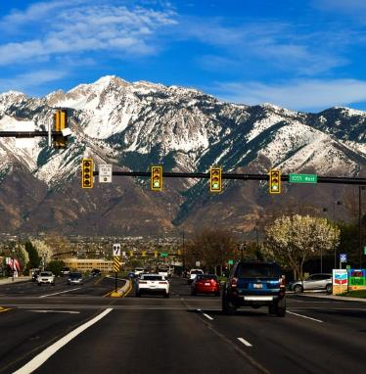

Lesson Objectives
Describe the different types of crowdsourced data
Understand differences between crowdsourced and traditional intelligent transportation systems (ITS) data
All Photos Source: Unsplash.

Slide 19

Crowdsourced Data Characteristics
Greater volume, velocity, and variety than traditional ITS Infrastructure
No roadside ITS infrastructure such as loop detectors required
Active or passive data collection
Real-time or archived data
Source: Unsplash.

Slide 20

Sources of Crowdsourced Data for Transportation Operations
Vehicle probe​
Navigation app​
Social media​
Connected vehicle​
311 and 511 apps ​
Multimodal probe data​
Source: Pixabay.

Slide 21

What is the typical frequency of real-time data from many common crowdsourced data providers?
Every second or two
Every minute or two
Every 10 or 20 minutes
Every hour or two
Source: Unsplash.

Slide 22
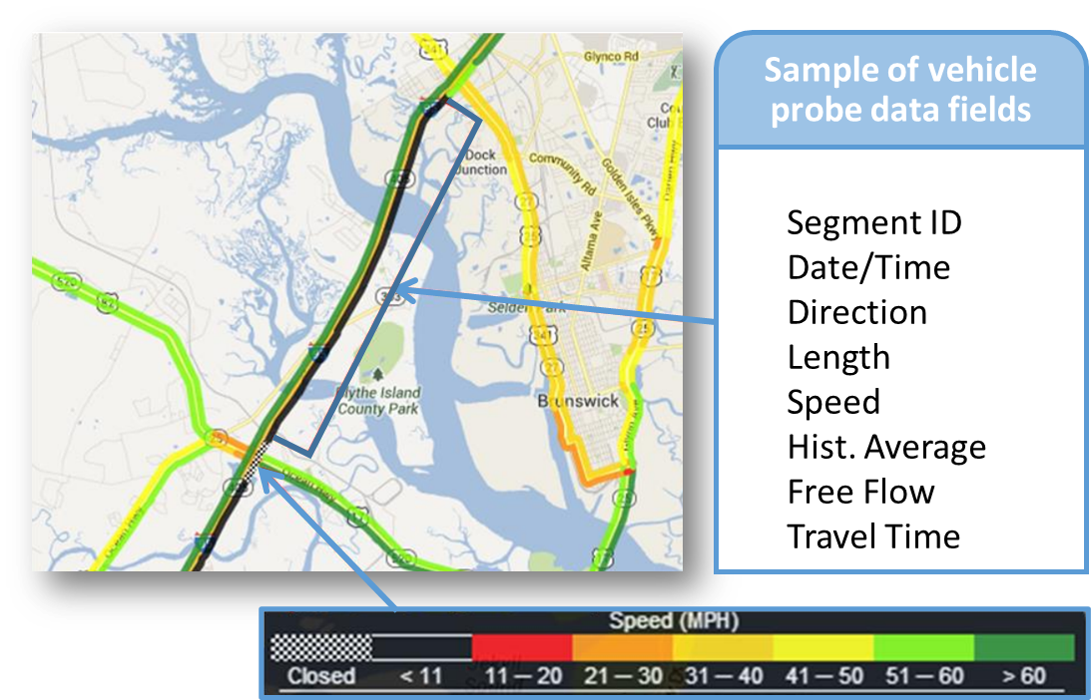
1. Vehicle Probe Data
Source data
Data providers
Data elements
Data frequency
Common uses
Source: Adapted from I-95 Vehicle Probe Project II Interface Guide, 2018.​

Slide 23
1. Vehicle Probe Data Characteristics
Characteristic | High-Level Descriptors
Data sources | Cellular triangulation, fleet and traveler Global Positioning System (GPS) devices or applications, connected vehicle data, and State or local ITS data.
Data providers | INRIX®, HERE®, TomTom®, Verizon®, and others.
Data elements | Speed and travel time by road segment, traffic event alerts, traffic tiles with color-coded speeds.
Data frequency | Typically, real-time data are transmitted every minute. Some vendors also offer archived data.
Common uses | Real-time traffic monitoring, real-time traveler information, archived data for performance, before and after studies, project prioritization, and planning for operations.

Slide 24
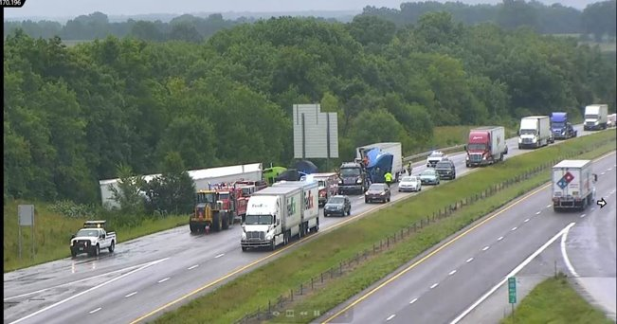
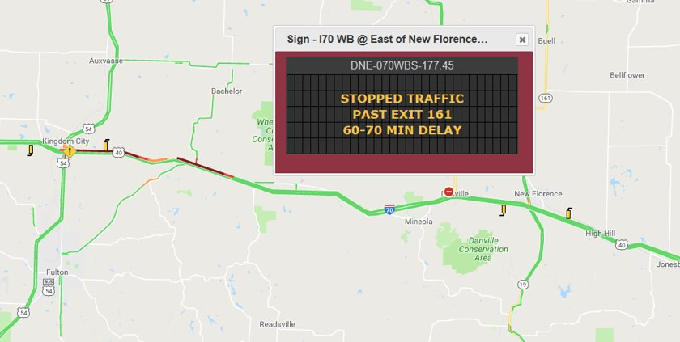
Missouri Crowdsourced Data Use Case #1: Rural Queue Warning System

Slide 25
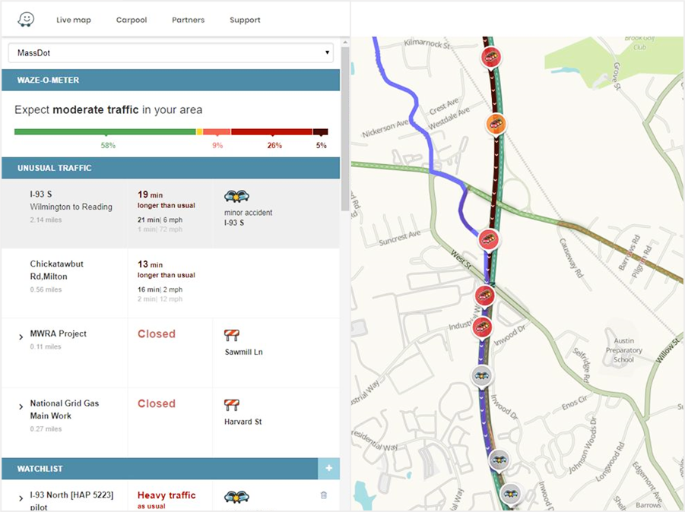
2. Navigation App Data
Source data
Data providers
Data elements
Data frequency
Common uses
Source: Massachusetts DOT, screen shot of event through Waze® Tool.

Slide 26
2. Navigation App Data Characteristics
Characteristic | High-Level Descriptors
Source data | User account data, traveler reports, mobile app GPS, historic data, State-provided road closure data.
Data providers | Waze®, Google Maps®, others.
Data elements | Waze provides jams (length, speed, delay), alerts (crashes, stalled vehicle, potholes, weather hazards), reliability and confidence scores.
Data frequency | Typically, real-time data are transmitted every 2 min. Some analytics vendor partners access 1-minute Waze® data.
Common uses | Real-time traffic monitoring, real-time traveler information, archived data for performance, before/after studies, traffic incident management, road weather management, work zone management, project prioritization, and operations planning.

Slide 27
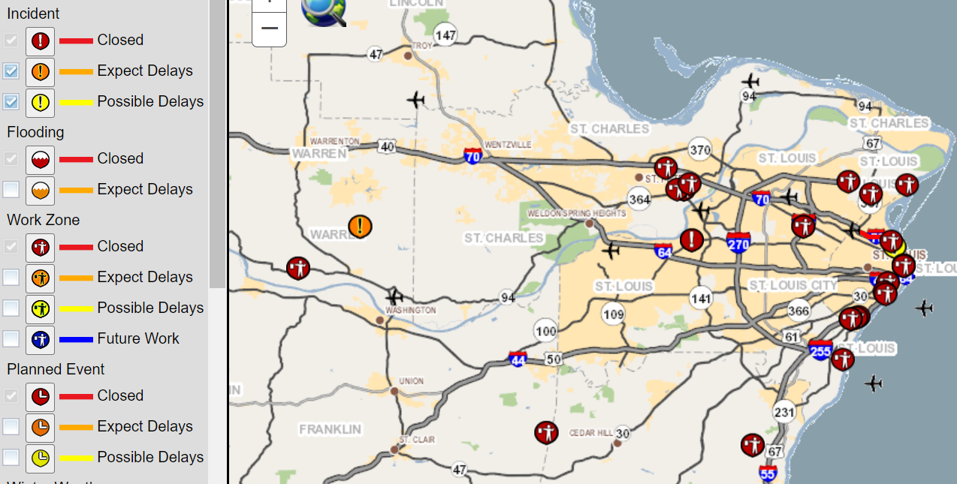
Missouri Crowdsourced Data Use Case #2 Waze Events for Incident Identification

Slide 28
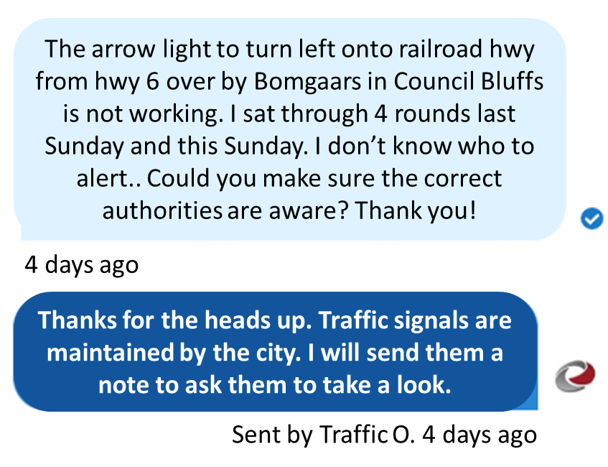
3. Social Media
Source data
Data providers
Data elements
Data frequency
Common uses
Source: Iowa DOT.

Slide 29
3. Social Media Characteristics
Characteristic | High-Level Descriptors
Source data | Individuals actively sharing information. State and local agency communication to the public.
Data providers | Twitter®, NextDoor®, Facebook®, Instagram®, blogs, LinkedIn®.
Data elements | Photo, text narrative, video, links to relevant information.
Data frequency | Near realtime.
Common uses | Planned special events, traveler information, public sentiment analysis.

Slide 30
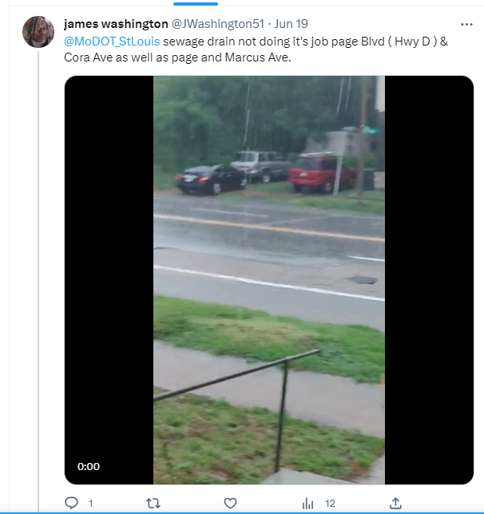

Missouri Crowdsourced Data Use Case #3 Social Media for Maintenance
Tweet to MoDOT_StLouis today
“sewage drain not doing it’s job”
Forward message to
MSDProject Clear

Slide 31
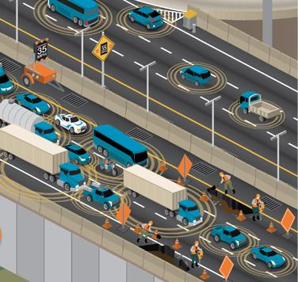
4. Connected Vehicle Data
Source data
Data providers
Data elements
Data frequency
Common uses
Source: U.S. Department of Transportation.

Slide 32
4. Connected Vehicle Data Characteristics
Characteristic | High-Level Descriptors
Source data | Onboard vehicle system among various major vehicle manufacturers.
Data providers | Wejo®, Ford Safety InsightsTM, ReplicaTM
Data elements | Varies. Some currently offered data include “breadcrumb” location, hard braking, windshield wiper status, speed, and aggregate analytics.
Data frequency | University research and private entities mainly exploring archived or near-real-time use—either semidaily, daily, weekly, or monthly content.
Common uses | Safety studies, transportation planning, before and after studies.

Slide 33
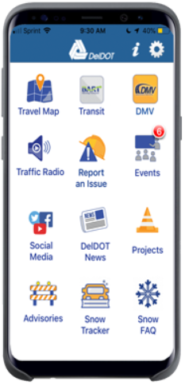
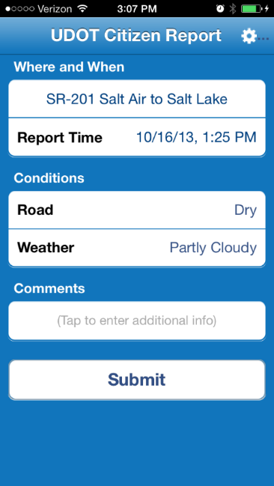
5. 311 and 511 Apps
Source data
Data providers
Data elements
Data frequency
Common uses
Source: Utah DOT.
Source: Delaware DOT.

Slide 34
5. Mobile/Web 311 and 511 App Characteristics
Characteristic | High-Level Descriptors
Source data | Typically, active reports by public.
Data providers | CivicPlus/SeeClickFix®, PublicStuff®, CitySourced®, and FixMyStreetTM provide 311 service. Agency-specific providers also support 511 applications.
Data elements | Transportation-focused report types include crashes, abandoned vehicles, infrastructure repair needs (pothole, traffic signal, sign), and object on road.
Data frequency | A few reports per week to dozens or more per day.
Common uses | Traveler information, road weather management, maintenance of roads and signals.

Slide 35


6. Multimodal Data
Source data
Data providers
Data elements
Data frequency
Common uses
Source: Unsplash.
Source: Unsplash.

Slide 36
6. Multimodal Data Characteristics
Characteristic | High-Level Descriptors
Source data | Active reports by public, passively collected by mobile app (e.g., bicycle, commercial vehicle, or transit app), smartphone, or device (e.g., dockless bicycle or scooters, or a dashboard camera).
Data providers | Examples: StreetLight DataTM and Nexar®
Data elements | Ridership, road user location and frequency, trip/route, financial statistics.
Data frequency | Varies by source.
Common uses | Long-term planning studies, micromobility policy development, alternate route planning, multimodal demand modeling.

Slide 37
Understand the Data Before Using It!
Accuracy depends on “market penetration” of data generators.
Data quality needs differ based on intended use.
Some data are a “Black Box” and requires routine validation.
Crowdsourced data do not measure traffic volumes.

Slide 38
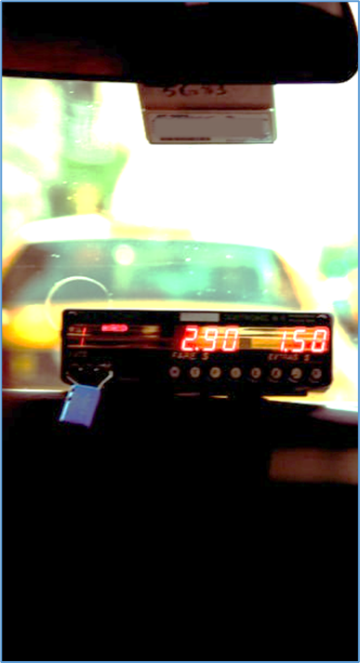
Crowdsourced Data Cost
Vehicle probe and connected vehicle data costs vary by coverage area, vendor, and data-sharing flexibility.
Some navigation app data is free through an agreement (e.g., Waze® for Cities).
Social media data can be monitored, but posting information comes with a cost.
All data, including crowdsourced data, require investment of staff time and data management resources.
Most data providers remove personally identifiable information prior to delivering data.
Source: Unsplash.

Slide 39

Knowledge Check No. 1
Which of the following data are considered crowdsourced data?
Vehicle probe data
Loop detector data
Navigation app data
Traffic signal data
A and C
Source: Unsplash.

Slide 40

Knowledge Check No. 2
Which of the following data is not readily available through crowdsourcing?
Speed data
Traffic incident data
Path or route data
Traffic volume data
Source: Unsplash

Slide 41

LESSON: Data Management INSTRUCTOR: Chris Lambert, KYTC
Source: Unsplash.

Slide 42
Lesson Objectives
Understand the importance of data management for crowdsourced and broader agency data.
Identify how modern data management differs from traditional data management.
All photos source: Unsplash.

Slide 43
Data Management Challenges
Internal resistance to data sharing
Storage and processing policies
Software policies
Technical know how
Resource constraints
Demonstrate value
In 2020 the California Utility Agency, which collects ride-hailing data, reversed a 7-year policy that precluded sharing it with transportation agencies.
https://www.sfcityattorney.org/2020/03/13/cpuc-follows-san-franciscos-urging-to-make-uber-lyft-data-public/

Slide 44

“Big” Crowdsourced and Other Data Needs for Data Management
Data volume, velocity, variety, and granularity are unprecedented.
Ways agencies traditionally manage data will not work or not work well.
Modern data management approaches offer greater data functionality and value.
Source: Unsplash.

Slide 45
Data Management Systems Are Evolving
Traditional Systems
Well-defined, fixed, purposed
Centralized storage and processing
Coupled hardware and software
Centralized data governance
Few access and use data
Extract transform load (ETL)
Modern Systems
Flexible, self-adjusting
Distributed storage and processing
Decoupled hardware and software
Distributed data governance
Many access and use data
Extract load transform (ELT)

Slide 46

Data Governance Evolution
Governance is part of the overall management of data.
Governance addresses topics of data ownership, processing, access, security, and other policy-setting efforts.
Decentralized, coordinated governance offers flexibility and accountability needed for “big” crowdsourced data.
Source: Pixabay.

Slide 47
Example: How do Agencies Manage Data from a Free Navigation Application?
Stored In-house Hadoop™ or Cloud, structured query language (SQL) or another database, third-party stored, or not stored
Filtered Filtering for crashes, by reliability score, by number of reports
Validated Mostly qualitative; some quantitative validation
Challenges Duplicate reports, integration with advanced traffic management system (ATMS) and 511 platforms, real-time analytics, long-term storage, attribution

Slide 48

Trends in Data Management
Data aggregation and storage
Quality controls
Data reproducibility
Outsourcing
Customization
Third-party data and tools use
Source: Pixabay.

Slide 49
Data Management at KYTC ITS Team
Presentation by Chris Lambert
Webinar | June 20, 2023

Slide 50
Vision
Striving to be national leaders in transportation who provide transportation infrastructure and services for the 21st century that deliver new economic opportunities for all Kentuckians.
Mission
To provide a safe, efficient, environmentally sound and fiscally responsible transportation system that delivers economic opportunity and enhances the quality of life in Kentucky.

Slide 51
General Purpose
Monitor
Communicate
Respond
Alert

Slide 52
Data Sources
HERE Traffic Speeds
HERE Incidents
Waze Jams
Waze Traffic Viewer
Waze Incidents
iCone Traffic Speeds
Twitter
KYMesonet
CoCoRahs
NWS Doppler Radar
NWS Forecasts
Statewide TMC Reports
Metro TMC Reports
Snowplows
Roadway Weather Stations
County SNIC Activity Reports
Dynamic Message Signs
Truck Parking
Permitted Work Zones
AASHTOWare SiteManager

Slide 53
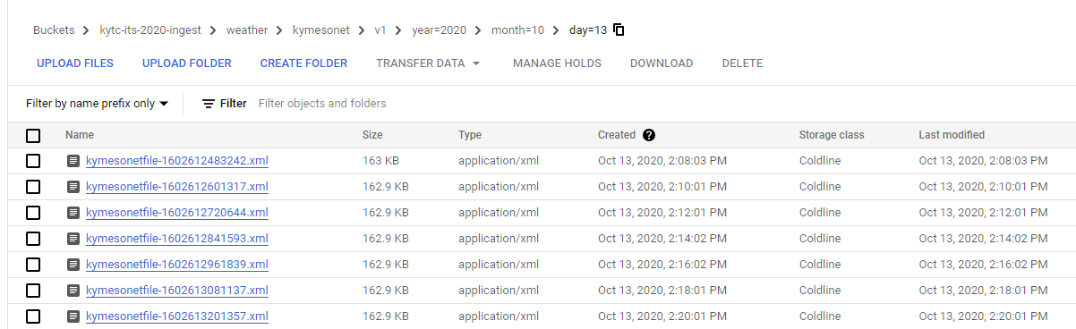
Raw Data
Stored as Native File Format: JSON, XML, CSV, DBF, etc.
Raw Data Folder Structure:
Type of Data
Provider
Version of API
Year
Month
Day
../type/provider/version/year/month/day

Slide 54
Processed Data
KYTC
Geo
Source Geo
Time
Source Date / Time
Route
Mile Point
KYTC Line
KYTC Point
County
Source
Metrics
Report Type
Capture Date / Time
Date & Time
Fayette
I-75
MP 115
Crash
10 ThumbsUp
District 7
Date & Time
Fayette
I-75
MP 115
Speed
25 MPH
District 7

Slide 55
On-Premise Architecture
Advantage:
Free compute*
Fixed cost
Works with traditional procurement processes
Disadvantages:
High upfront cost of servers
Replacement of servers
Maintenance of server OS, etc.
More technical for end-users
Limited visualization tools
Limited sharing behind firewall
Difficulty scaling

Slide 56
Cloud Architecture
Advantage:
Inexpensive storage
More scalable
No maintenance
More end-user friendly
More visualization options
More flexibility for sharing
Disadvantages:
Expensive compute
Variability in cost, required different procurement process
Keep an eye on changes in service provider terms

Slide 57
Cloud Costs Depend on Use Case
KYTC ITS, Real-Time Data: ~$20k/month
110TB of Raw and Processed Data
Storage (data lake, cold storage) = 6%
Pub/Sub (messaging middleware) = 40%
SQL (storage + usage) = 48%
KYTC Photolog / LiDAR: ~$46k/month
100TB NetApp, Hot Storage = 41%
300TB Cloud Storage = 40%
Windows VMs = 14%
SQL = 1%

Slide 58
Visualization and Analytics
Our Current Tool Set:
Kibana & Elasticsearch by Elastic.co, “elegant and lightning fast”
PowerBI by Microsoft, “user friendly”
Looker Studio by Google, “free, web-based”
UrbanSDK by UrbanSDK, “data science and analytics”

Slide 59
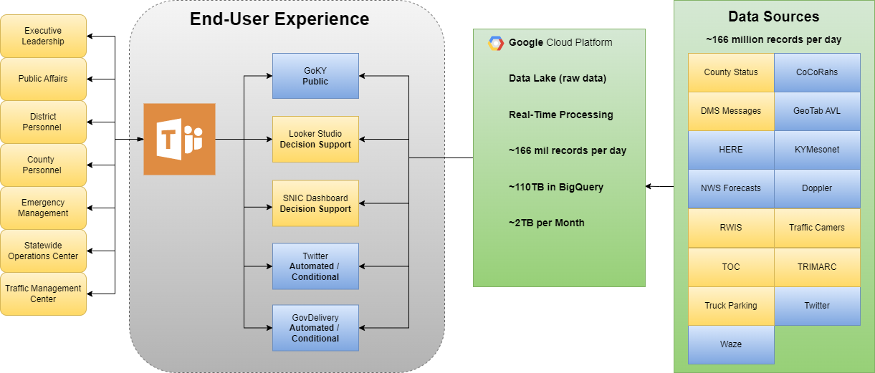
Combine People & Data

Slide 60
General Use Cases
DATA
Monitoring
Analysis
Alerts
Summaries
Ad Hoc
Analytics
After Action
Detection

Slide 61
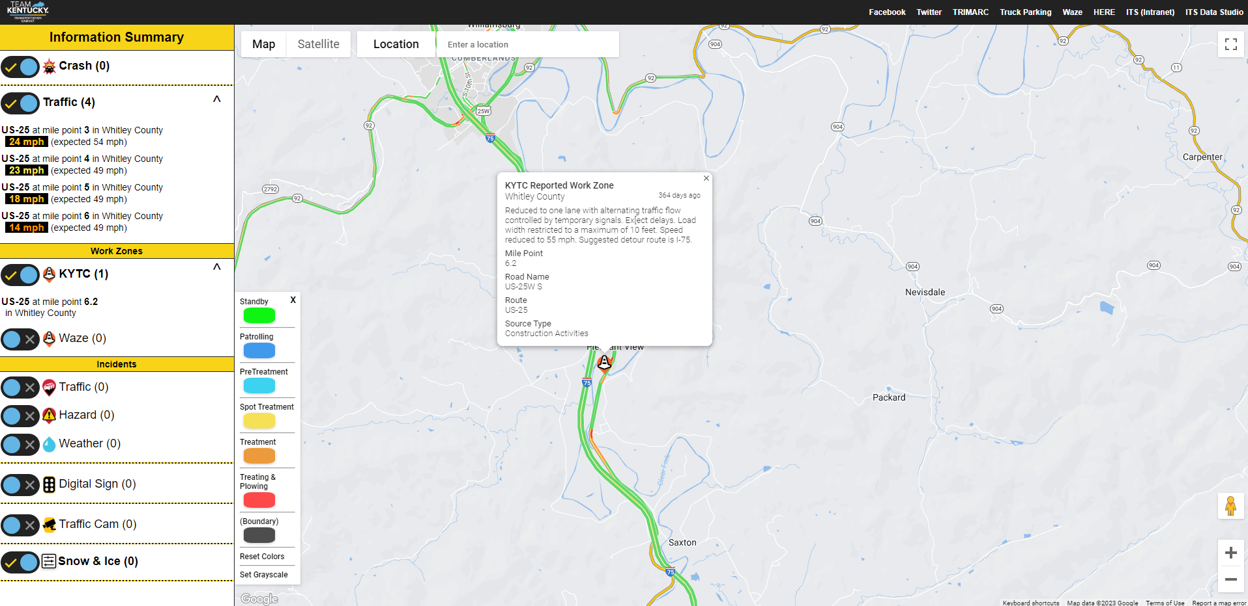
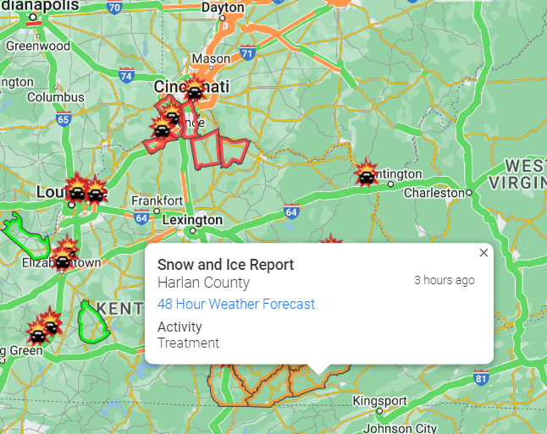
Monitoring

Slide 62
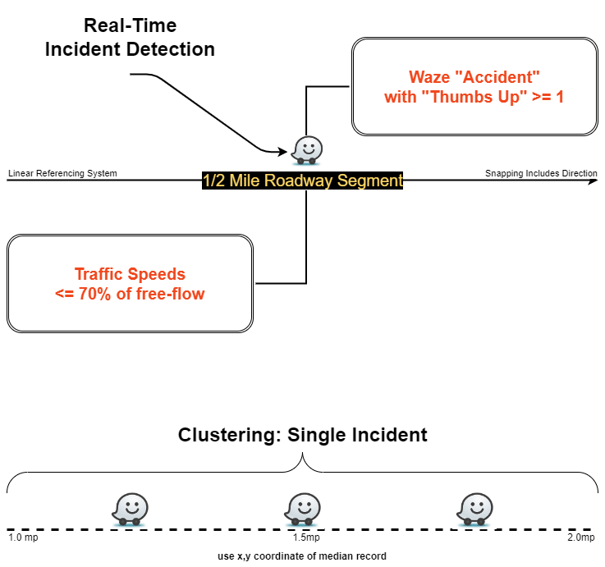
Detection

Slide 63
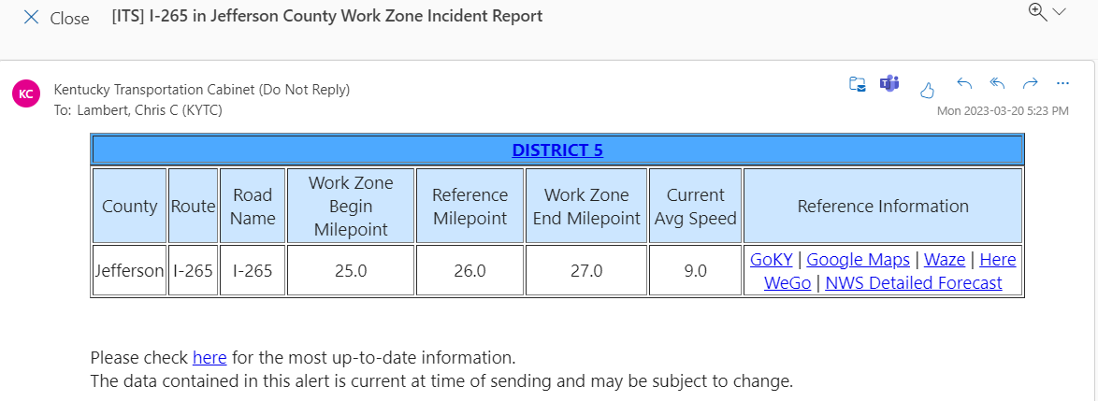
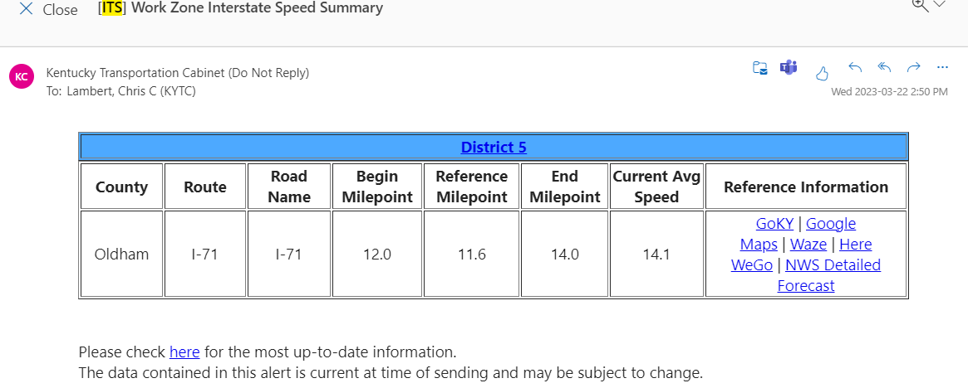
Alerts
Crash Reported in Work Zone
Work Zone averages 25mph or less for 10min or more.

Slide 64
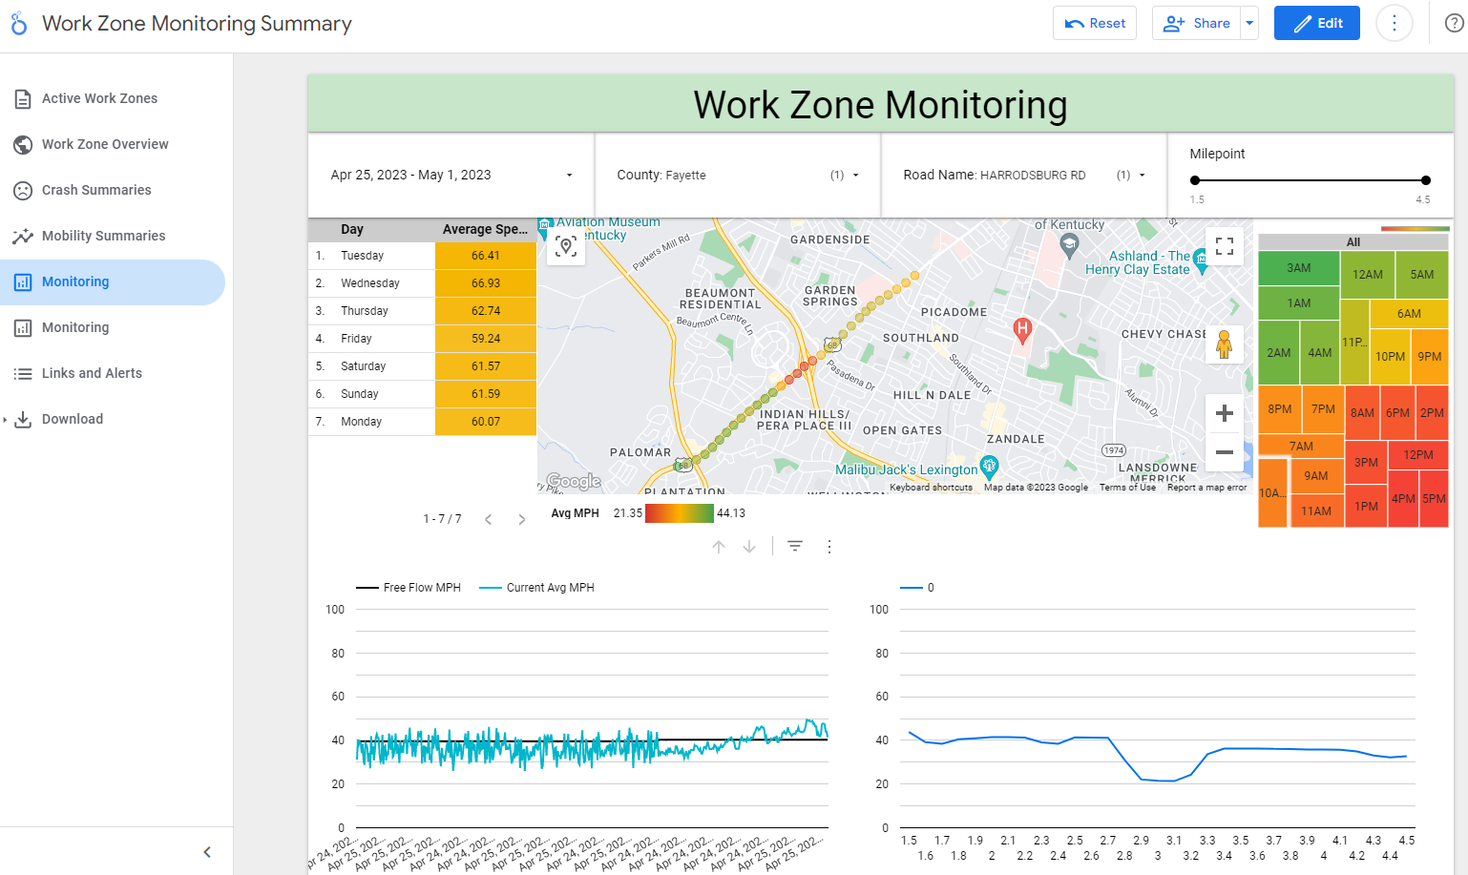
Analysis

Slide 65
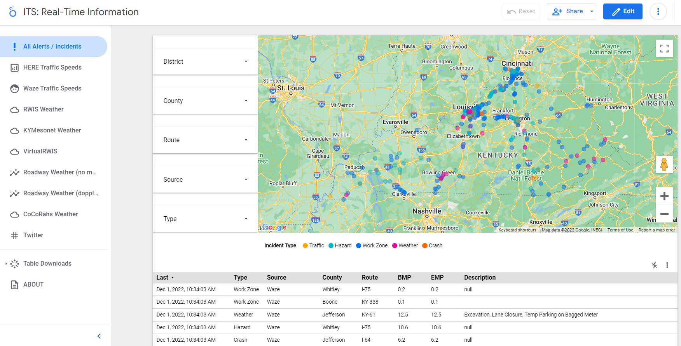
Summaries

Slide 66
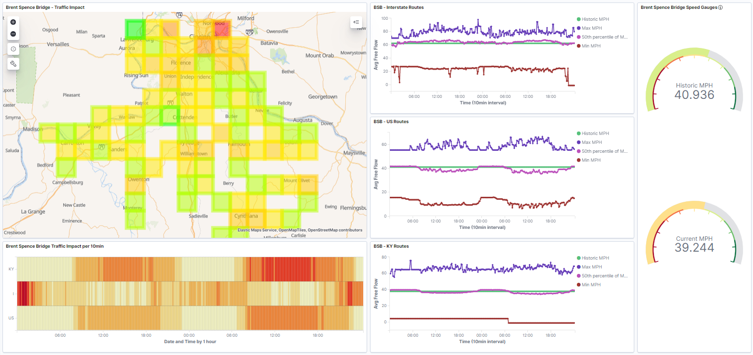
Ad Hoc Analysis

Slide 67
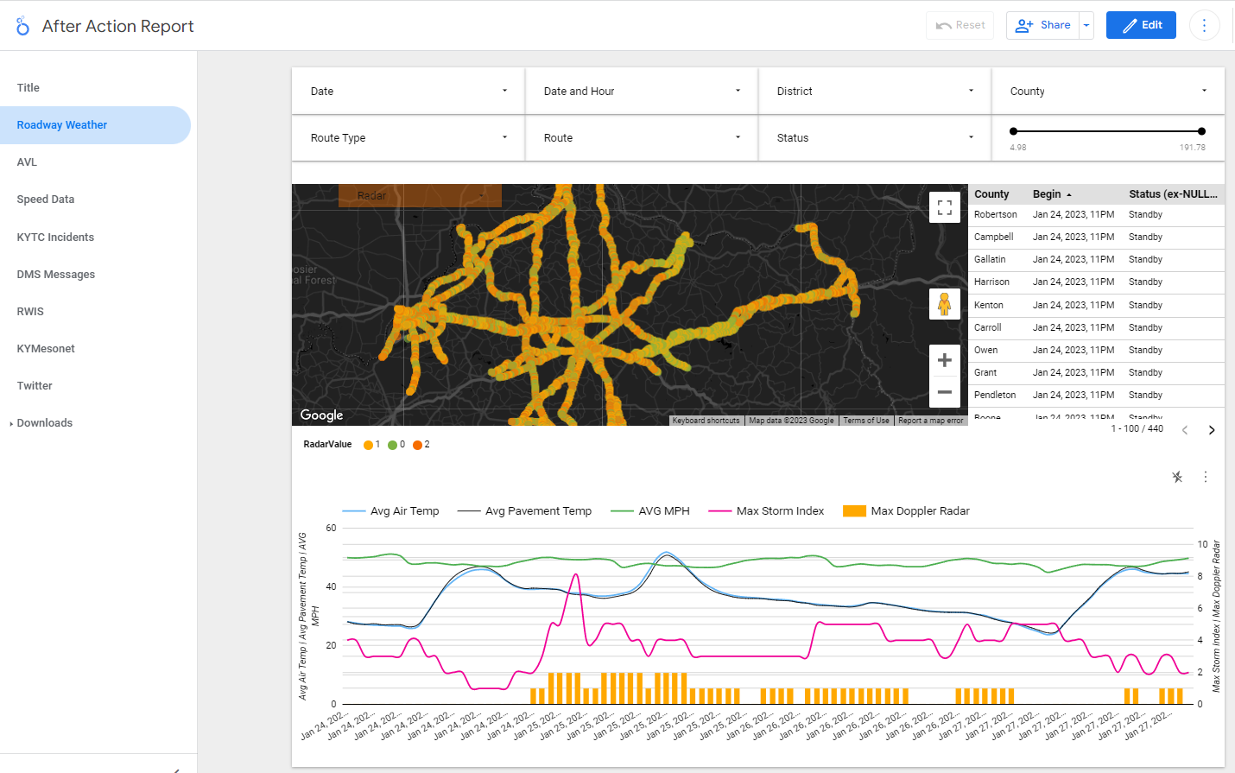
After Action

Slide 68
Knowledge Check No. 1
Why is data management important for crowdsourced and broader agency data?
Keeps data organized and usable
Keeps data safe and accessible
Keeps data indefinitely
A and B
Source: Unsplash.

Slide 69
Knowledge Check No. 2
Which of the following are characteristic of modern data management?
Distributed storage and processing
Decoupled hardware/software
Many access and use the data
All the above
Source: Unsplash.

Slide 70
What is Your Agency’s State of Practice Regarding Modern Data Management?
1 – nonexistent
2 – exploration
3 – some demonstrations
4 – practiced by some groups
5 – institutionalized (or nearly institutionalized)
6 – Not sure

Slide 71
Chris.Lambert@ky.gov
@ChrisLambertKY

Slide 72

Question, Answer, and Discussion
Source: Pixabay.

Slide 73

Crowdsourced Data Resources
Adventures in Crowdsourcing webinar on Validating Crowdsourced Data
Lake County Free Travel Time Poller: Free GitHub Code for Waze® Connected Cities partners to send email alerts for defined road segments that become "congested."
The Eastern Transportation Coalition Coalition Vehicle Probe Project: INRIX®, HERE®, and TomTom® resource guides and validation reports.
Source: FHWA.
FHWA EDC-6 Crowdsourcing for Advancing Operation Resource Site (bit.ly/CS4Ops)

Slide 74
Data Management Resources
Adventures in Crowdsourcing webinars with data management content:
Data Management and Governance
New Destinations with FHWA EDC-6 Innovation: Modern Data Management
National Cooperative Highway Research Program Report 952 Guidebook for Managing Data from Emerging Technologies for Transportation
FHWA Data Business Plan Report
Source: FHWA.
FHWA EDC-6 Crowdsourcing for Advancing Operation Resource Site (bit.ly/CS4Ops)

Slide 75
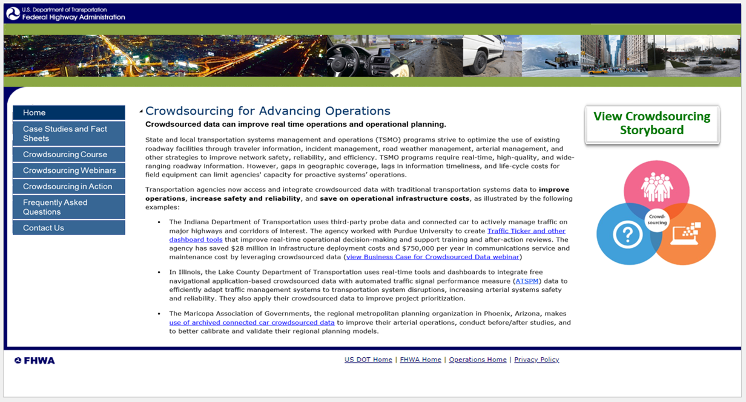
Crowdsourcing Beyond Round Six of the Every Day Counts (EDC) Program
New web presence
Continue course delivery
Continue technical support
Continue free access to the EDC-6 Adventures in Crowdsourcing webinar series hosted by the National Operations Center of Excellence
Source: FHWA.
Concept website in development and intended for FHWA Office of Operations.

Slide 76
Thank you.
James Colyar
james.colyar@dot.gov
360‒753‒9408
Greg Jones
gregm.jones@dot.gov
404‒895‒6220
Ralph Volpe
ralph.volpe@dot.gov
404‒985‒1268

Slide 77
Upcoming T3 Webinars
Webinar | Date | Time
Crowdsourcing for Advancing Operations: Traveler Information and Traffic Incident Management | Tuesday, July 18, 2023 | 1:00 P.M. - 2:30 P.M. ET
Crowdsourcing for Advancing Operations: Road Weather and Arterial Management | Tuesday, August 15, 2023 | 1:00 P.M. - 2:30 P.M. ET
Crowdsourcing for Advancing Operations: Emergency and Work Zone Management and Next Steps | Tuesday, September 19, 2023 | 1:00 P.M. - 2:30 P.M. ET
Register: https://www.pcb.its.dot.gov/t3_webinars.aspx
To access the recording and past T3 webinars, visit:
https://www.pcb.its.dot.gov/t3_archives.aspx

Slide 78
Feedback
A link to a feedback questionnaire is provided in the chat pod. Please take a few minutes to fill it out – we value your input
To receive notifications of upcoming events, send an email to T3@dot.gov with “Add to mailing list” in the subject line
Thank you!

